Slide 1
Upcoming WP3 Deliverables
Lose Ends
D3.3 Catalogue service (M40, DEC, PU, ESS)
D3.4 Implementation Report from Facilities (M44, R, PU, ESS)
D3.5 NeXus Metadata Mapping Schema and Proposed New Definitions (M42, R, PU, ESS)
Things that are conceptually complete but still require work to roll out at the partner sites:
Rollout of search API at partners and connecting up to live catalogues
Local integration of experiments into data catalogues
Full coverage of OAI-PMH exposure by all partners
PMT Dashboard will help!
https://github.com/panosc-eu/panosc/wiki/Work-Packages-dashboards#wp3--data-catalog-services
Priorities
Search scoring and merging
Defined vocabularies for parameters and techniques + local curation and mapping
Revision of search API/Data Model
Stress testing aggregation, filtering and searching across facilities
Search as a service and in the WP4 portal

Slide 2
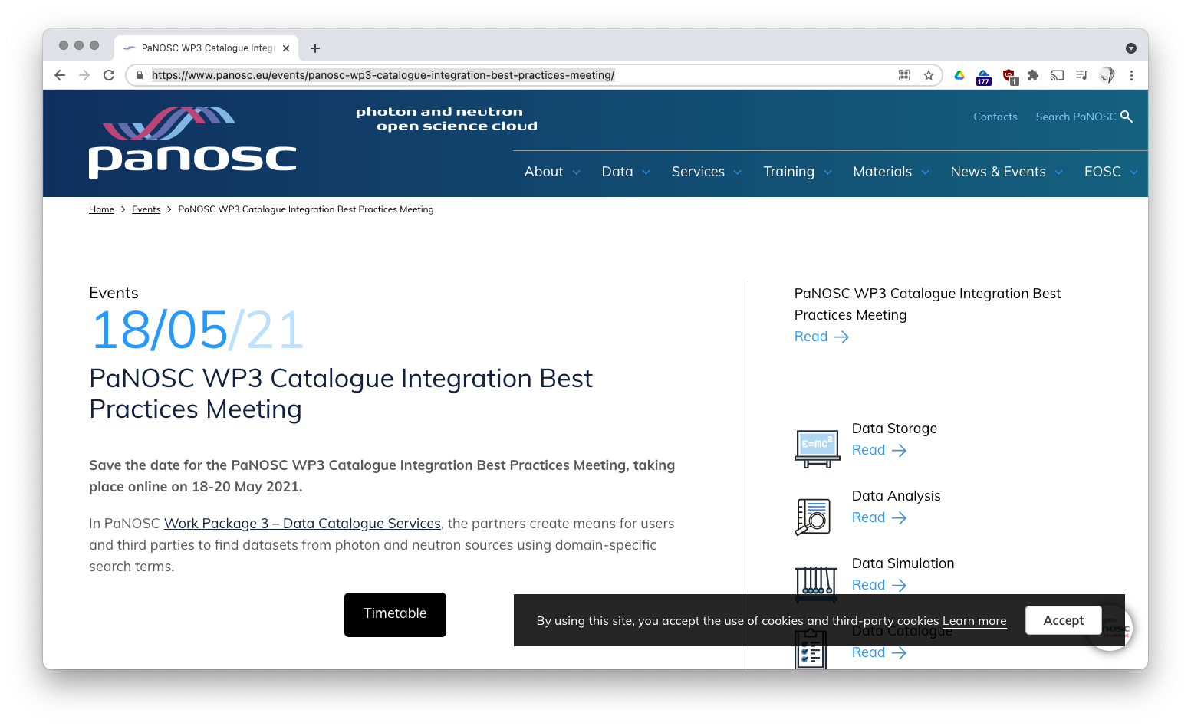
https://www.panosc.eu/events/panosc-wp3-catalogue-integration-best-practices-meeting/

